Slide 1


Privacy-preserving Triangle Counting in Directed Graphs
Ziyao Wei¹, Qing Liu^{1,2}, Zhikun Zhang^{1,2}, Shouling Ji¹, Yunjun Gao^{1,2}
¹College of Computer Science and Technology, Zhejiang University,
²Zhejiang Key Laboratory of Big Data Intelligent Computing
{wei_zy, qingliucs, zhikun, sji, gaoyj}@zju.edu.cn
Notes:
Hi everyone! My name is Ziyao Wei, I am from Zhejiang University. I will introduce our work: Privacy-preserving Triangle Counting in Directed Graphs. This is a joint work with Qing Liu, Zhikun Zhang, Shouling Ji, and Yunjun Gao.

Slide 2
CONTENTS
Motivation & Contributions
Preliminaries
Algorithms
Experiments
Conclusions
Notes:
My presentation will unfold from the following five parts.

Slide 3
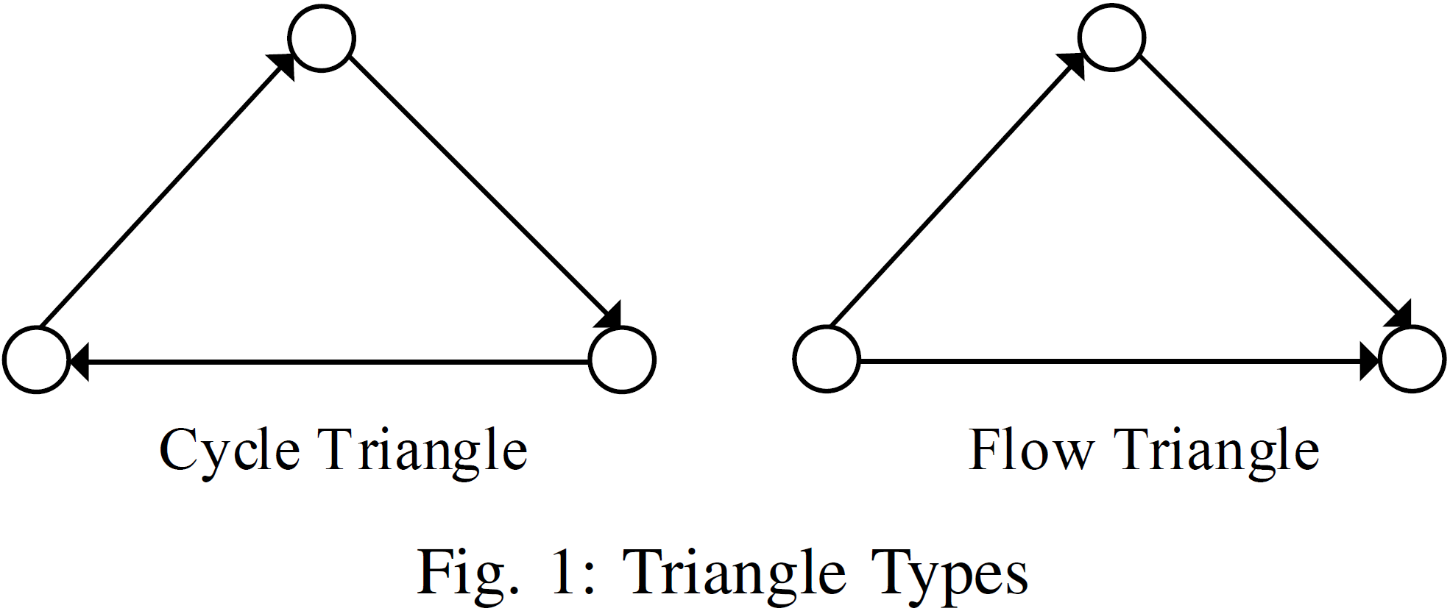
Motivation
In directed graphs, triangles, which are different from those in undirected graphs, include two distinct types, cycle triangles and flow triangles.
Notes:
First I will introduce the background.
In directed graphs, triangles, which are different from those in undirected graphs, include two distinct types, cycle triangles and flow triangles.
When we count the triangles in a directed graph, both the numbers of cycle and flow triangles need to be released.

Slide 4
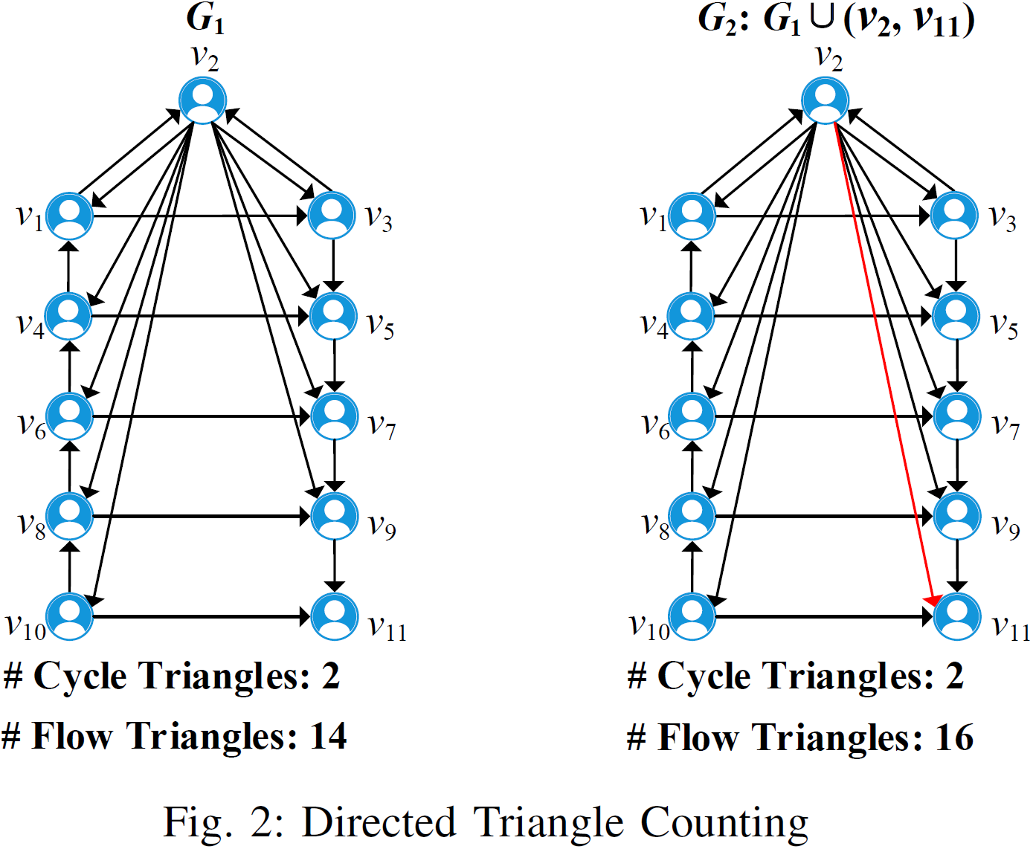
Motivation
Disclosing the exact numbers of cycle and flow triangles in directed graphs might leak users’ private relationships.
Notes:
Disclosing the exact numbers of cycle and flow triangles in directed graphs might leak users’ private relationships. For example, let G1 and G2 are two social networks differing by only one edge (v2, v11). Assume that the attacker already knew that the user $v_{2}$’s following list contains all other vertices except v11. Since G1 and G2 have different numbers of flow triangles, the attacker can use the triangle information to infer the relationship (v2,v11). Therefore, it is necessary to protect the triangles’ information in directed graphs. Motivated by this, for the first time, we study the problem of privacy-preserving triangle counting in directed graphs.

Slide 5
Contributions
We address the problem of triangle counting in directed graphs with differential privacy.
We propose a centralized algorithm with differential privacy guarantees.
We develop a locally differentially private algorithm.
We conduct comprehensive experiments on six real-world datasets.
Notes:
Our main contributions are as follows:
First, we address the problem of triangle counting in directed graphs with differential privacy.
Second, we propose a centralized algorithm with differential privacy guarantees.
Third, we develop a locally differentially private algorithm.
Finally, we conduct comprehensive experiments on six real-world datasets.

Slide 6
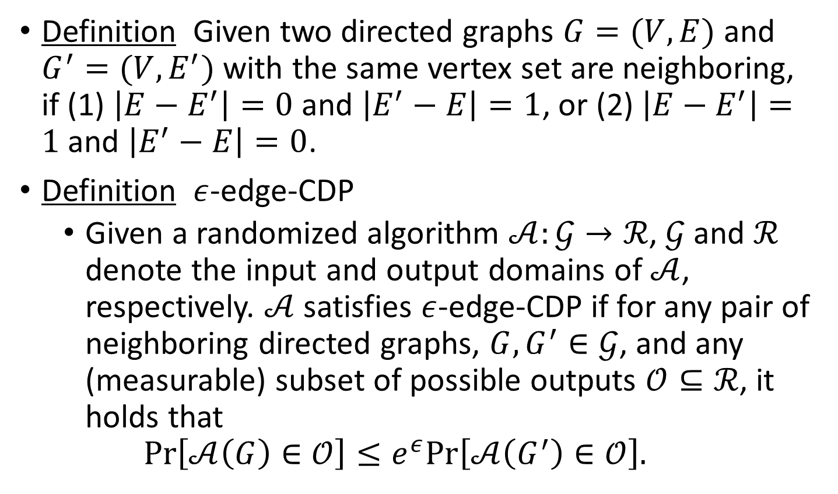
Preliminaries
Definition Given two directed graphs $G=(V,E)$ and $G^{′}=(V,E^{′})$ with the same vertex set are neighboring, if (1) $\left|E−E^{′}\right|=0$ and $\left|E^{′}−E\right|=1$, or (2) $\left|E−E^{′}\right|=1$ and $\left|E^{′}−E\right|=0$.
Definition $ε$-edge-CDP
Given a randomized algorithm $𝒜:𝒢→ℛ$, $𝒢$ and $ℛ$ denote the input and output domains of $𝒜$, respectively. $𝒜$ satisfies $ε$-edge-CDP if for any pair of neighboring directed graphs, $G,G^{′}∈𝒢$, and any (measurable) subset of possible outputs $𝒪⊆ℛ$, it holds that
$$Pr\left[𝒜\left(G\right)∈𝒪\right]≤e^{ε}Pr\left[𝒜\left(G^{′}\right)∈𝒪\right].$$
Notes:
Next, we give some definitions、theorems and properties.
We first define the neighboring directed graphs and $ε$-edge-CDP. Two neighboring directed graphs have the same vertex set and only differ in one edge. For any pair of neighboring directed graphs, the $ε$-edge-CDP requires that $𝒜$ produces similar output distributions.

Slide 7
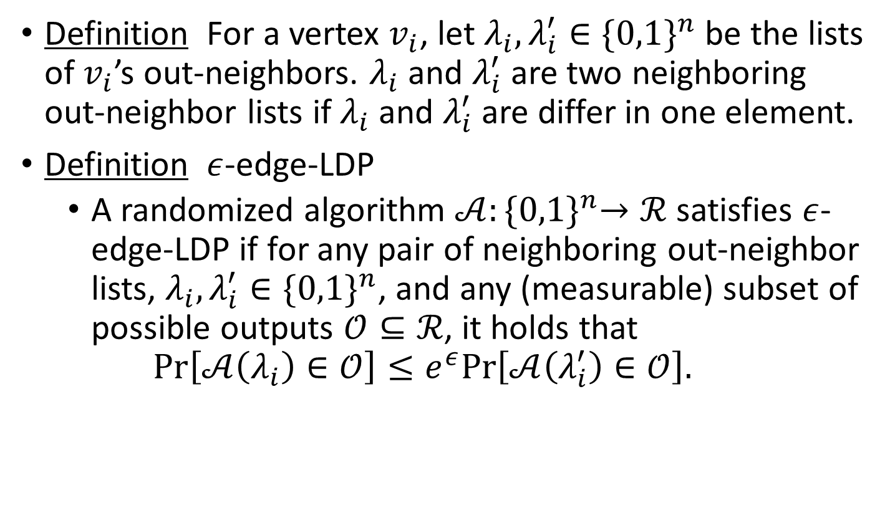
Preliminaries
Definition For a vertex $v_{i}$, let $λ_{i}, λ_{i}^{′}∈{\{0,1\}}^{n}$ be the lists of $v_{i}$’s out-neighbors. $λ_{i}$ and $λ_{i}^{′}$ are two neighboring out-neighbor lists if $λ_{i}$ and $λ_{i}^{′}$ are differ in one element.
Definition $ε$-edge-LDP
A randomized algorithm $𝒜:{\{0,1\}}^{n}→ℛ$satisfies $ε$-edge-LDP if for any pair of neighboring out-neighbor lists, $λ_{i}, λ_{i}^{′}∈{\{0,1\}}^{n}$, and any (measurable) subset of possible outputs $𝒪⊆ℛ$, it holds that
$$Pr\left[𝒜\left(λ_{i}\right)∈𝒪\right]≤e^{ε}Pr\left[𝒜\left(λ_{i}^{′}\right)∈𝒪\right].$$
Notes:
Then, we define neighboring out-neighbor lists and $ε$-edge-LDP. Two neighboring out-neighbor lists only differ in one element. For any pair of neighboring out-neighbor lists, the $ε$-edge-LDP requires that $𝒜$ produces similar output distributions.

Slide 8
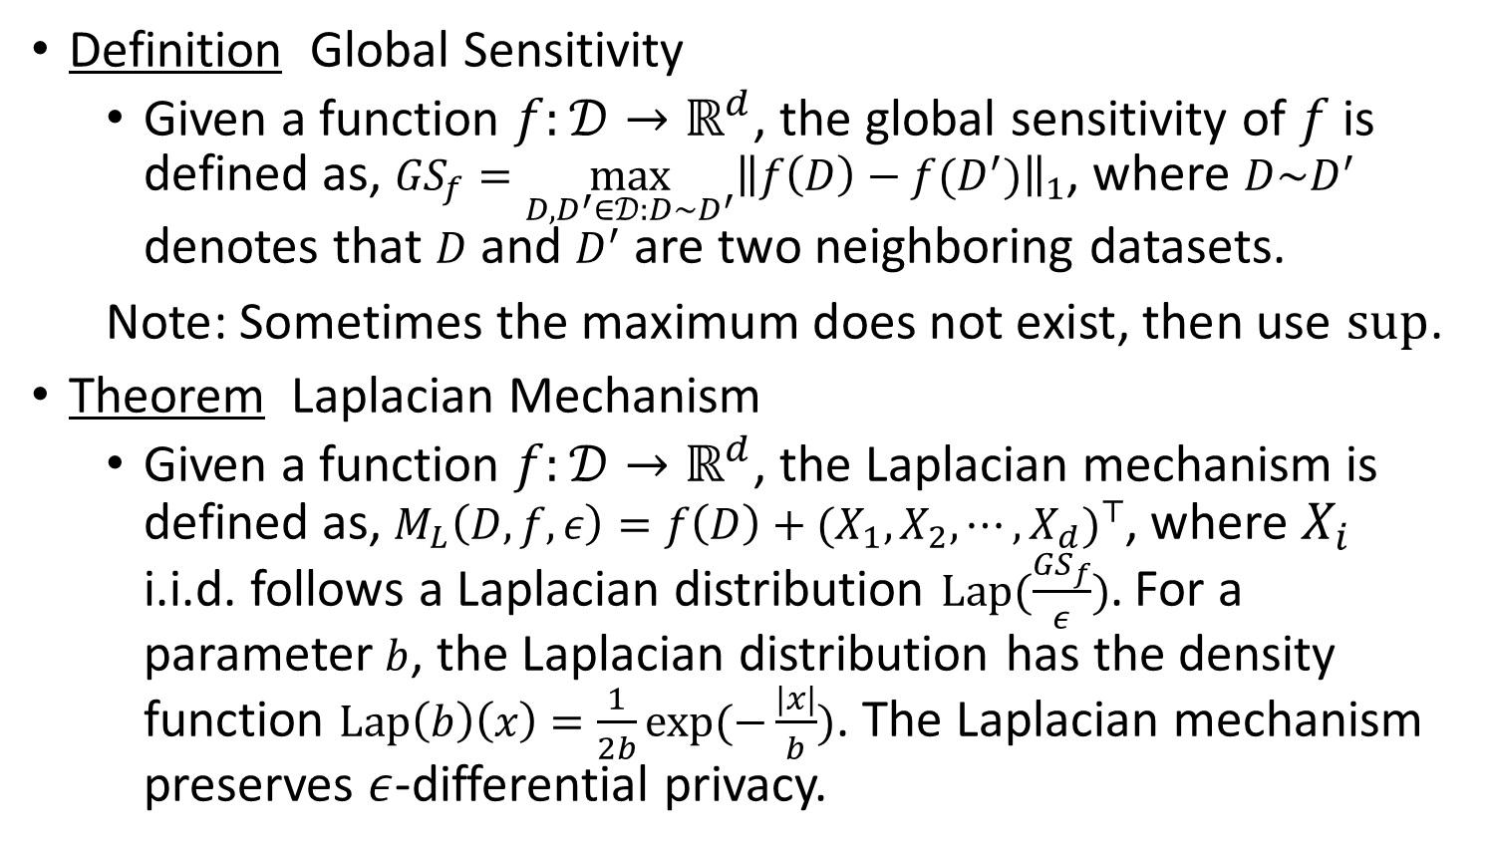
Preliminaries
Definition Global Sensitivity
Given a function $f:𝒟→ℝ^{d}$, the global sensitivity of $f$ is defined as, ${GS}_{f}=\max_{D,D^{′}∈𝒟:D\sim D^{′}}{{\left\|f\left(D\right)−f(D^{′})\right\|}_{1}}$, where $D\sim D^{′}$ denotes that $D$ and $D^{′}$ are two neighboring datasets.
Note: Sometimes the maximum does not exist, then use $sup$.
Theorem Laplacian Mechanism
Given a function $f:𝒟→ℝ^{d}$, the Laplacian mechanism is defined as, $M_{L}\left(D,f,ε\right)=f\left(D\right)+{(X_{1},X_{2},⋯,X_{d})}^{⊤}$, where $X_{i}$ i.i.d. follows a Laplacian distribution $Lap(\frac{{GS}_{f}}{ε})$. For a parameter $b$, the Laplacian distribution has the density function $Lap\left(b\right)\left(x\right)=\frac{1}{2b}exp(−\frac{|x|}{b})$. The Laplacian mechanism preserves $ε$-differential privacy.
Notes:
Next, to implement differential privacy, we define global sensitivity and provide Laplacian mechanism. Given a data analysis function $f$, the Laplacian mechanism adds Laplacian noise to $f$ to achieve differential privacy. The scale of the Laplacian noise is determined by the global sensitivity ${GS}_{f}$ of the function $f$ and the privacy budget $ε$.

Slide 9
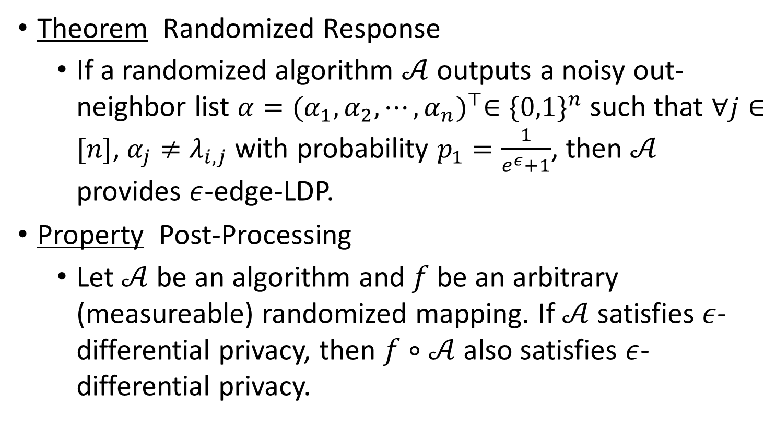
Preliminaries
Theorem Randomized Response
If a randomized algorithm $𝒜$ outputs a noisy out-neighbor list $α={(α_{1},α_{2},⋯,α_{n})}^{⊤}∈{\{0,1\}}^{n}$ such that $∀j∈[n]$, $α_{j}≠λ_{i,j}$ with probability $p_{1}=\frac{1}{e^{ε}+1}$, then $𝒜$ provides $ε$-edge-LDP.
Property Post-Processing
Let $𝒜$ be an algorithm and $f$ be an arbitrary (measureable) randomized mapping. If $𝒜$ satisfies $ε$-differential privacy, then $f∘𝒜$ also satisfies $ε$-differential privacy.
Notes:
Then, we provide randomized response, which can be used to implement $ε$-edge-LDP. Differential privacy has several nice properties. Next, we provide 3 useful properties of differential privacy. The first one is post-processing.

Slide 10
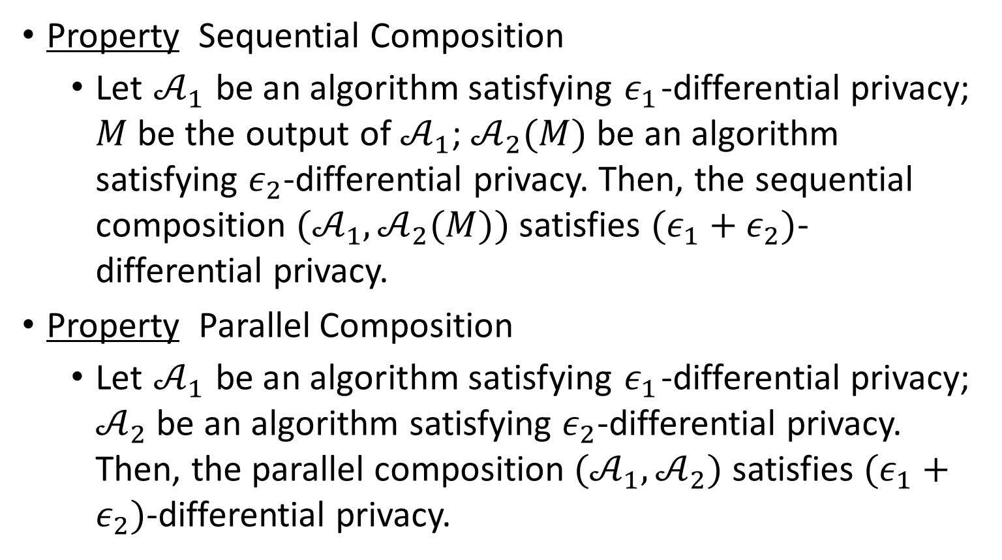
Preliminaries
Property Sequential Composition
Let $𝒜_{1}$ be an algorithm satisfying $ε_{1}$-differential privacy; $M$ be the output of $𝒜_{1}$; $𝒜_{2}(M)$ be an algorithm satisfying $ε_{2}$-differential privacy. Then, the sequential composition $(𝒜_{1},𝒜_{2}(M))$ satisfies $(ε_{1}+ε_{2})$-differential privacy.
Property Parallel Composition
Let $𝒜_{1}$ be an algorithm satisfying $ε_{1}$-differential privacy; $𝒜_{2}$ be an algorithm satisfying $ε_{2}$-differential privacy. Then, the parallel composition $(𝒜_{1},𝒜_{2})$ satisfies $(ε_{1}+ε_{2})$-differential privacy.
Notes:
There are two other properties of differential privacy, called sequential composition and parallel composition.

Slide 11
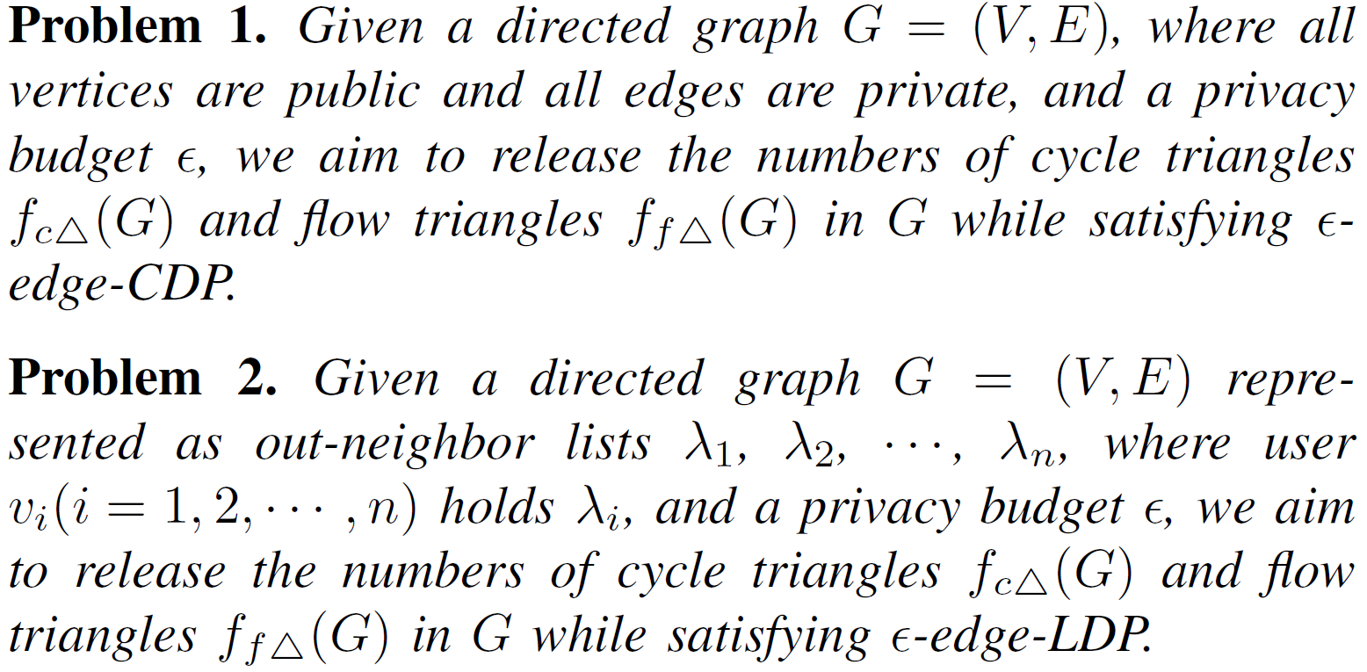
Problem Definition
Notes:
Now we introduce the problems we have studied in this paper. The Problem1 aims to release the numbers of cycle triangles and flow triangles in a directed graph while satisfying $ε$-edge-CDP. The Problem2 aims to release the numbers of cycle triangles and flow triangles in a directed graph while satisfying $ε$-edge-LDP.

Slide 12
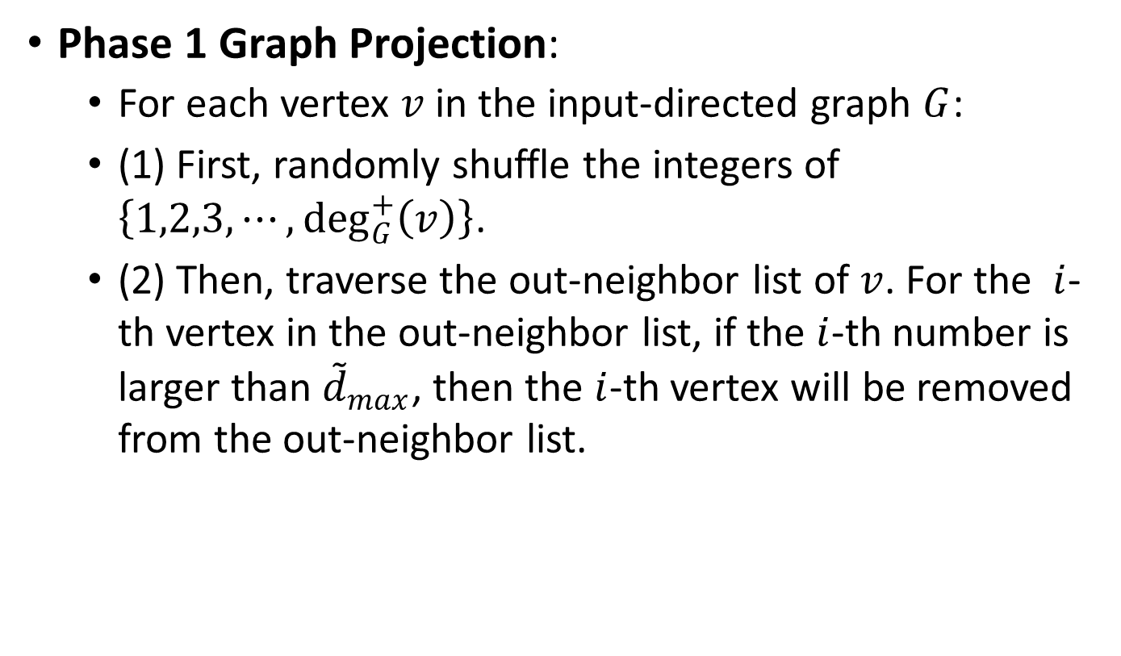
Centralized Algorithm
Phase 1 Graph Projection:
For each vertex $v$ in the input-directed graph $G$:
(1) First, randomly shuffle the integers of $\left\{1,2,3,⋯,\deg_{G}^{+}\left(v\right)\right\}$.
(2) Then, traverse the out-neighbor list of $v$. For the $i$-th vertex in the out-neighbor list, if the $i$-th number is larger than ${\tilde{d}}_{max}$, then the $i$-th vertex will be removed from the out-neighbor list.
Notes:
We introduce the details of the proposed centralized algorithm. The Phase 1 of centralized algorithm is the graph projection. The graph projection aims to reduce the maximum out-degree of vertices in the input-directed graph. After graph projection, the out-degree of each vertex in the projected-directed graph would not exceed ${\tilde{d}}_{max}$, where ${\tilde{d}}_{max}$ is given projection degree.

Slide 13
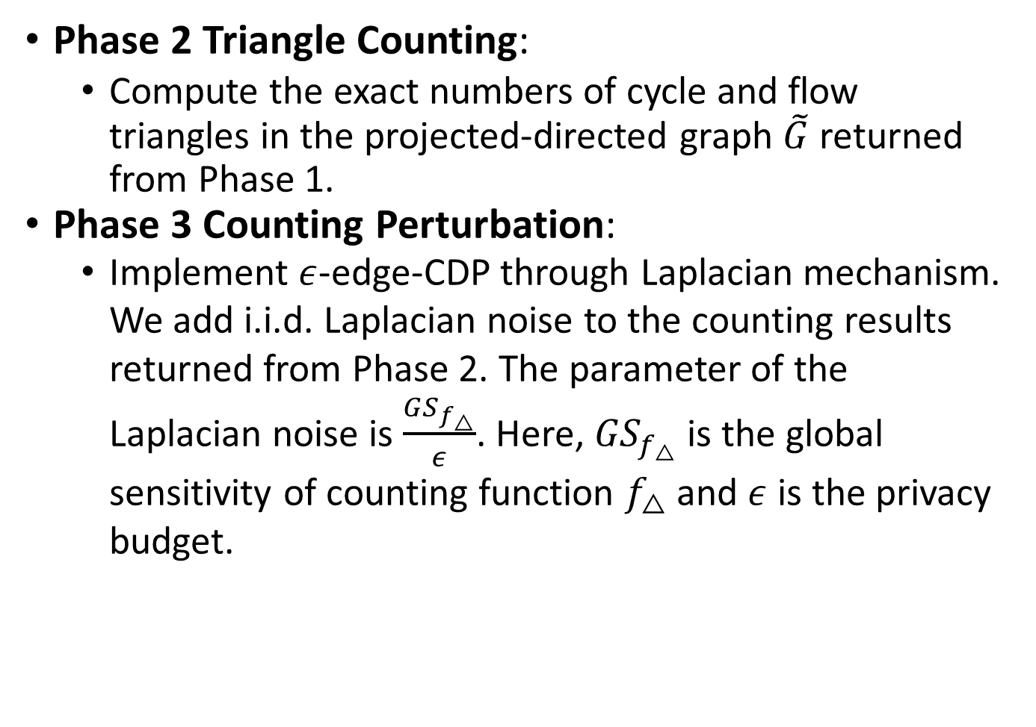
Centralized Algorithm
Phase 2 Triangle Counting:
Compute the exact numbers of cycle and flow triangles in the projected-directed graph $\tilde{G}$ returned from Phase 1.
Phase 3 Counting Perturbation:
Implement $ε$-edge-CDP through Laplacian mechanism. We add i.i.d. Laplacian noise to the counting results returned from Phase 2. The parameter of the Laplacian noise is $\frac{{GS}_{f_{△}}}{ε}$. Here, ${GS}_{f_{△}}$ is the global sensitivity of counting function $f_{△}$ and $ε$ is the privacy budget.
Notes:
The Phase 2 and Phase 3 are the triangle counting and counting perturbation, respectively. The Phase 2 computes the exact numbers of cycle and flow triangles in the projected-directed graph $\tilde{G}$ returned from Phase 1. The Phase 3 implements $ε$-edge-CDP through Laplacian mechanism.

Slide 14
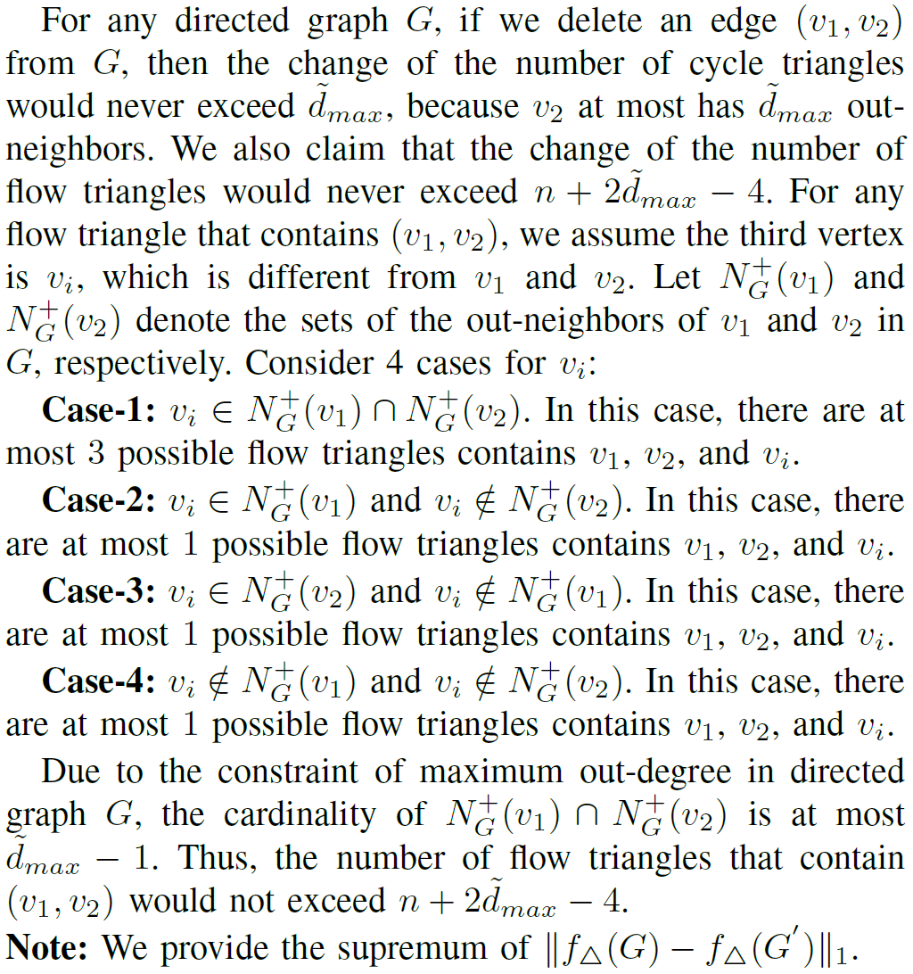
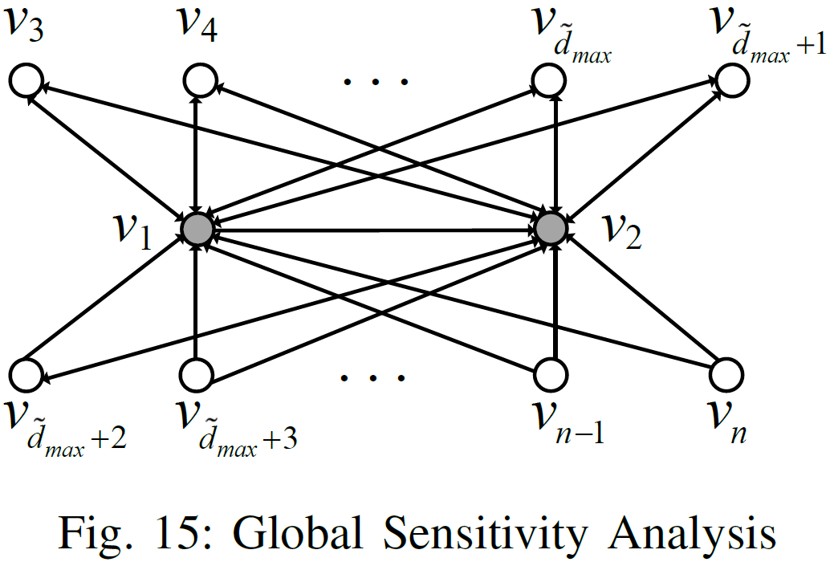
Centralized Algorithm
Sensitivity Analysis
Notes:
In the Phase 3, to analyze the sensitivity of the counting function. We construct a case-directed graph, based on which we can deduce the largest difference in the total number of cycle and flow triangles resulting from the addition or removal of a specific edge.

Slide 15
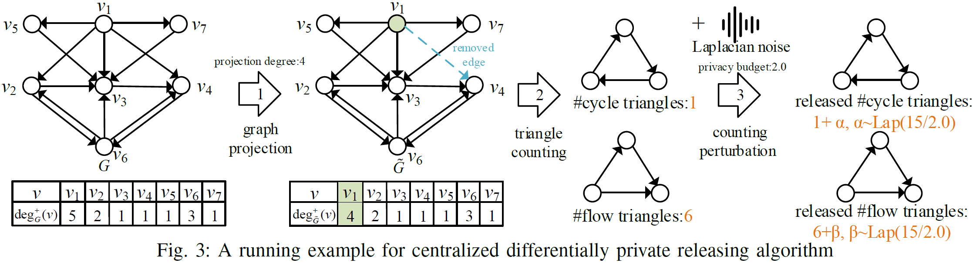
Centralized Algorithm
Example
Notes:
As shown in the figure, there is an example for counting the numbers of cycle and flow triangles in a directed graph through the proposed centralized differentially private releasing algorithm.

Slide 16
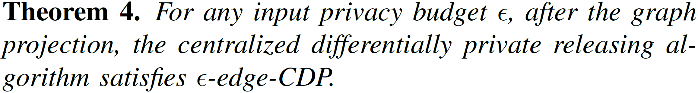
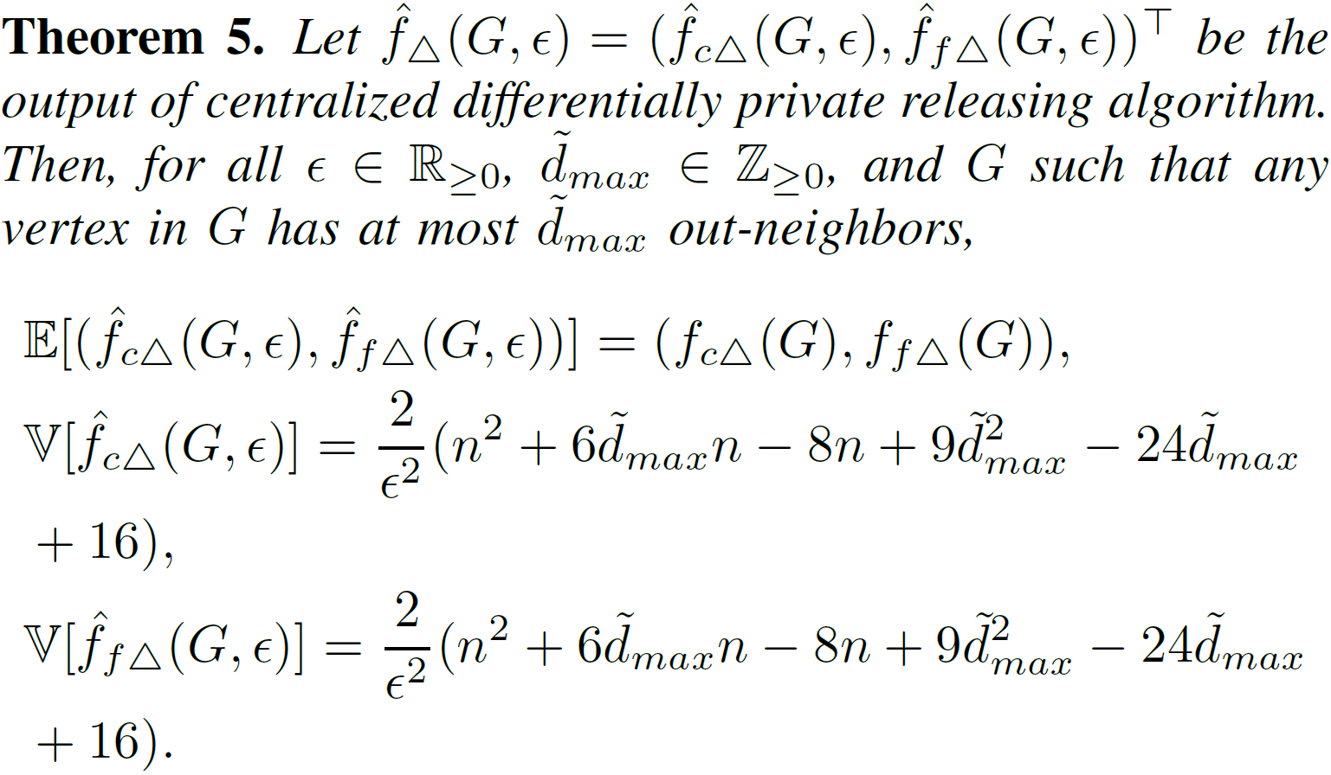
Centralized Algorithm
Algorithm Analysis
Notes:
Then, we discuss the privacy and utility of the proposed centralized algorithm. As shown in Theorem 4, we prove that after the graph projection, the proposed centralized algorithm satisfies $ε$-edge-CDP. As shown in Theorem 5, we confirm that the algorithmic output is an unbiased estimation for the exact numbers and we also provide the variance of the algorithmic output.

Slide 17
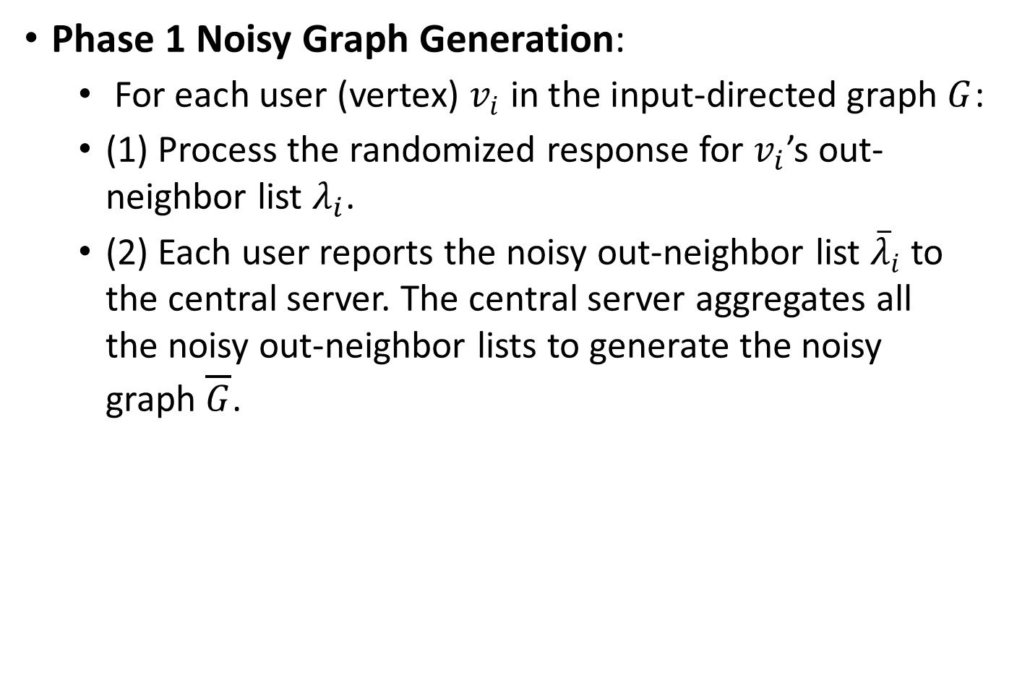
Local Algorithm
Phase 1 Noisy Graph Generation:
For each user (vertex) $v_{i}$ in the input-directed graph $G$:
(1) Process the randomized response for $v_{i}$’s out- neighbor list $λ_{i}$.
(2) Each user reports the noisy out-neighbor list ${\overline{λ}}_{i}$ to the central server. The central server aggregates all the noisy out-neighbor lists to generate the noisy graph $\overline{G}$.
Notes:
Next, we introduce the details of the proposed local algorithm. The first phase of the local algorithm is noisy graph generation. This phase generates the noisy graph through running randomized response on each user side.

Slide 18
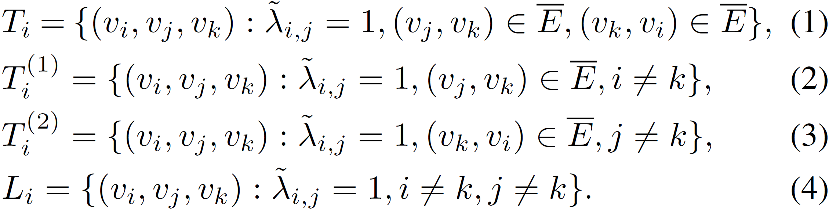
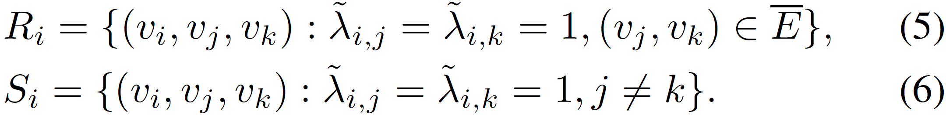
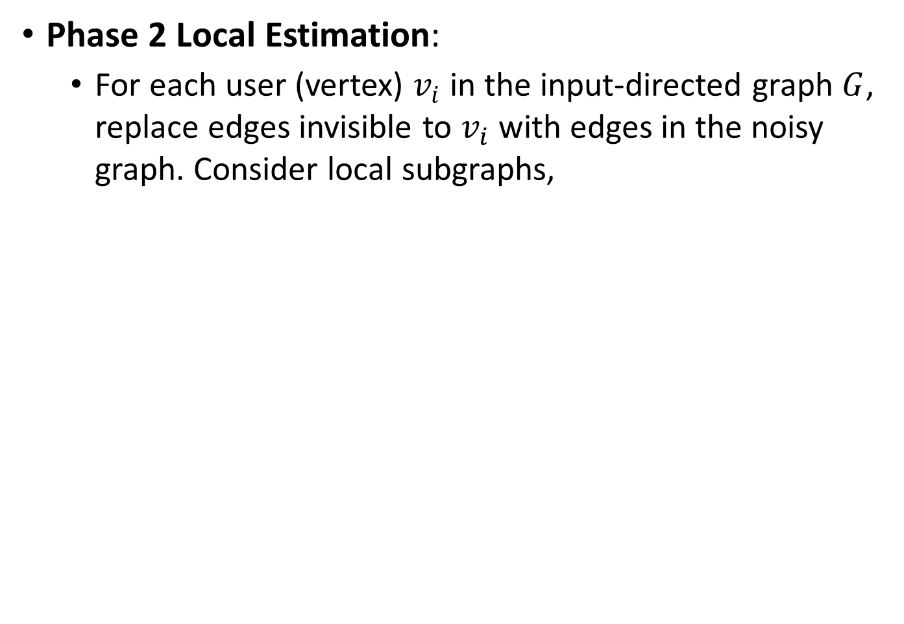
Local Algorithm
Phase 2 Local Estimation:
For each user (vertex) $v_{i}$ in the input-directed graph $G$, replace edges invisible to $v_{i}$ with edges in the noisy graph. Consider local subgraphs,
Notes:
The second phase of the local algorithm is local estimation. Here, Ti represents the set of local cycle triangles containing vi; Ti^{(1)} represents the set of local cycle 2-stars starting from vi; Ti^{(2)} represents the set of local cycle 2-stars whose middle vertex is vi; Li represents the set of local single edges starting from vi; Ri represents the set of local flow triangles containing vi; Si represents the set of local flow 2-stars whose central vertex is vi. On each user vi side, vi first downloads the noisy graph, then counts the numbers of these local subgraphs. Based on these numbers, vi generates the local estimation and report it to the central server. Finally, the central server aggregates all the local estimations to obtain the released numbers.

Slide 19
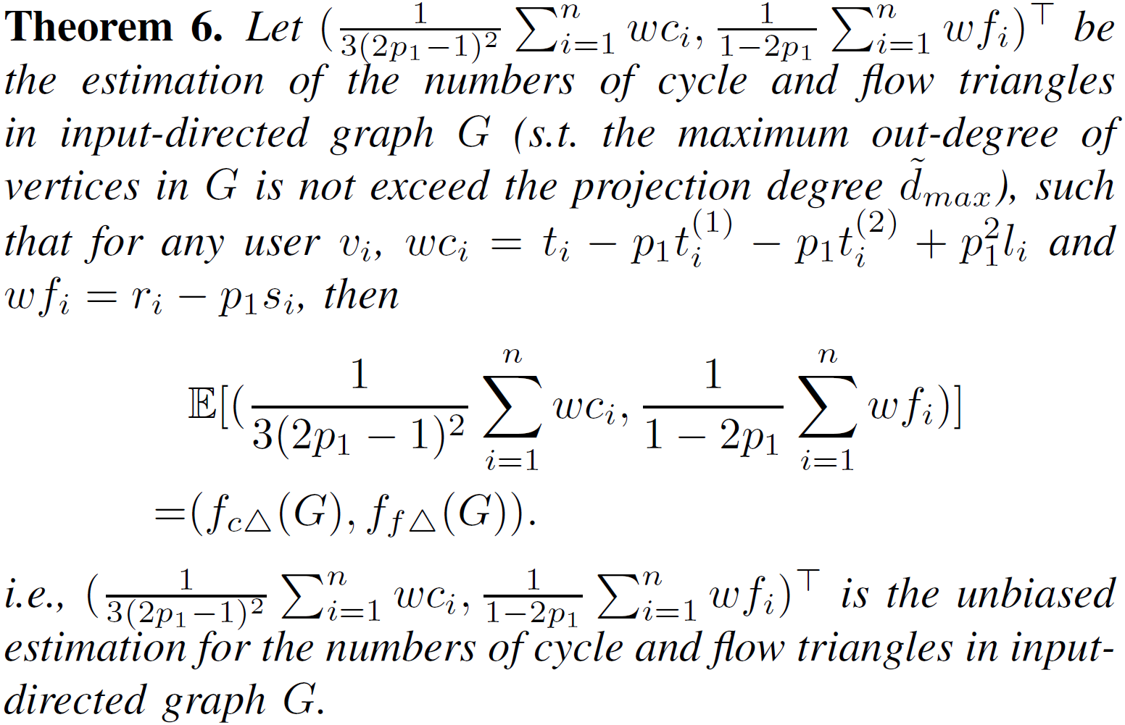
Local Algorithm
Phase 2 Local Estimation:
Notes:
We prove that when using this local estimation on each user side, the central server can aggregate all the local estimations to an unbiased estimation for the number of cycle and flow triangles in input-directed graph.

Slide 20
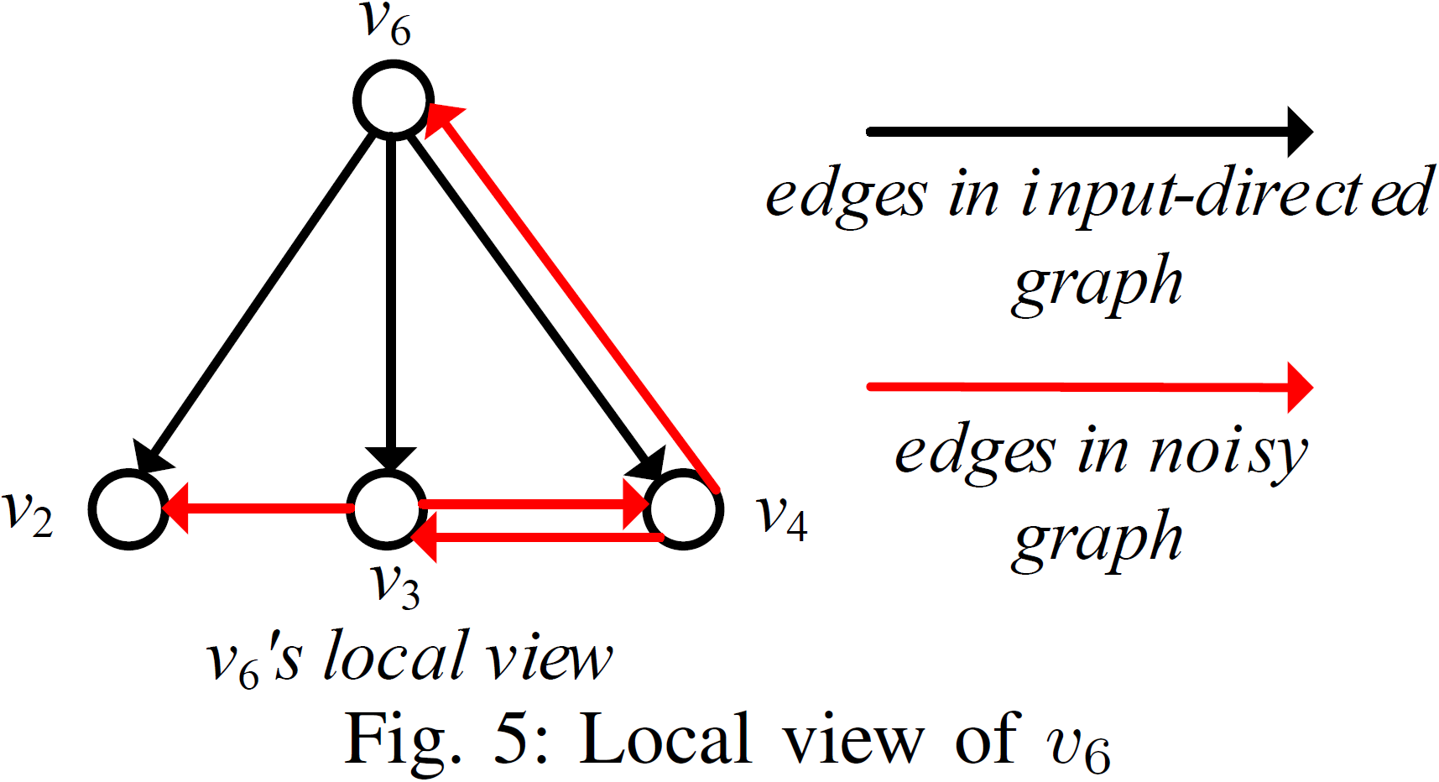
Local Algorithm
Phase 2 Local Estimation:
Example
Notes:
As shown in this figure, the black lines denote the edges that v6 could view. The red lines denote the edges in the noisy graph. Based on this information, we can count the numbers of local subgraphs on v6 side.

Slide 21
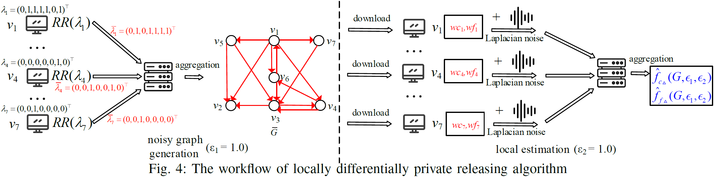
Local Algorithm
Workflow
Notes:
As shown in the figure, there is the workflow for counting the numbers of cycle and flow triangles in a directed graph through locally differentially private releasing algorithm .

Slide 22
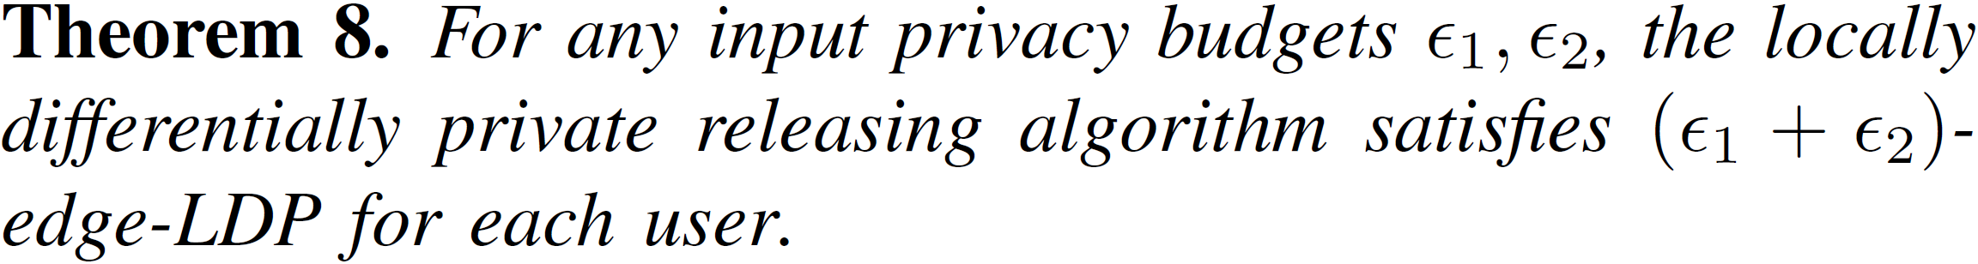
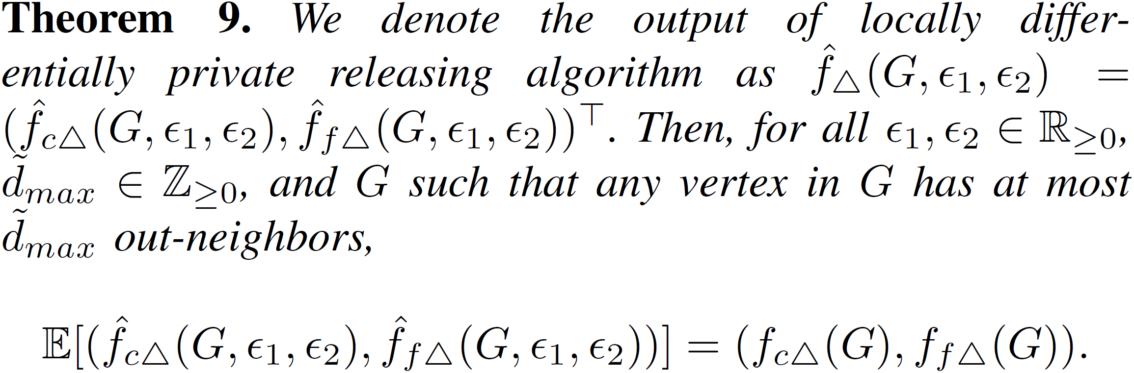
Local Algorithm
Algorithm Analysis
Notes:
Then, we discuss the privacy and utility of the proposed local algorithm. As shown in Theorem 8, we prove that the proposed local algorithm satisfies $(ε1+ε2)$-edge-LDP for each user. As shown in Theorem 9, we confirm that the algorithmic output is an unbiased estimation for the exact numbers.

Slide 23
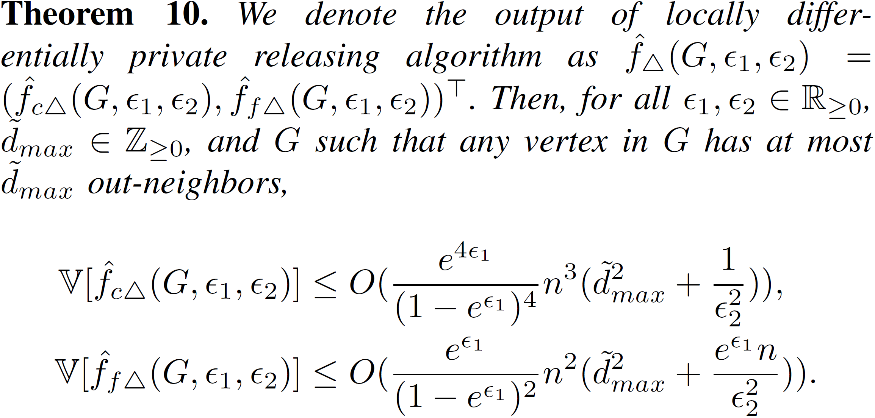
Local Algorithm
Algorithm Analysis
Notes:
As shown in Theorem 10, we provide the upper bounds of the variance of the algorithmic output.

Slide 24
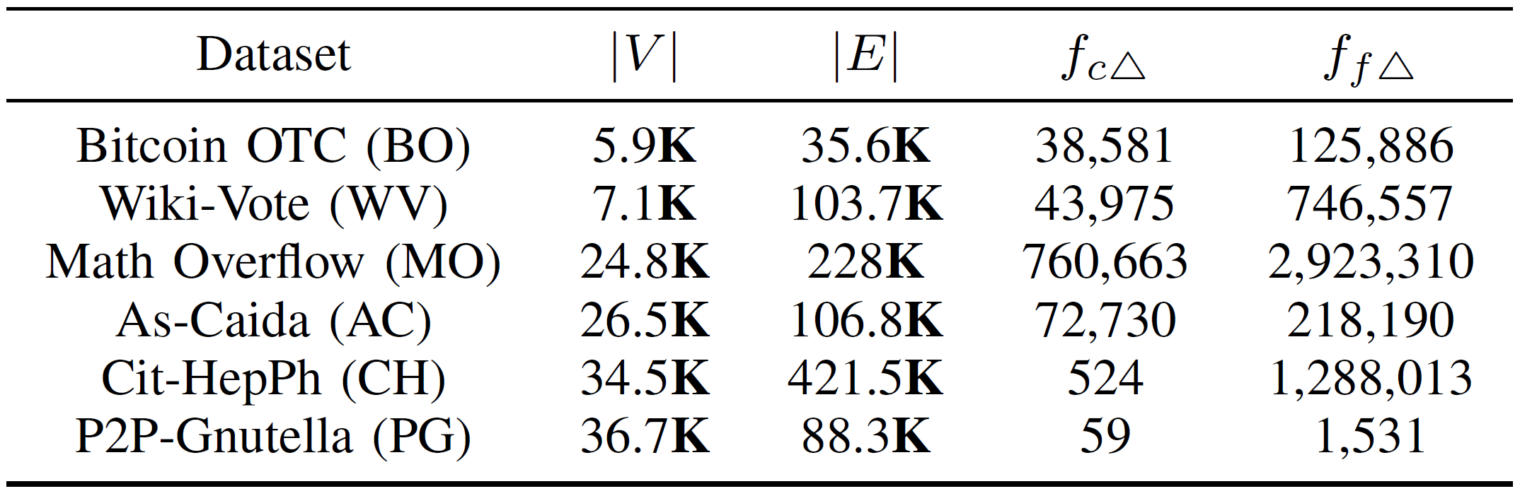
Experiments
Datasets
Algorithms
CDP Naive: The strawman centralized solution
CDP: Our proposed centralized solution
LDP Naive: The strawman local solution
LDP: Our proposed local solution
Notes:
Next, we present experimental results for our proposed algorithms.
In experiments, We use six real world graphs, and compare 4 methods.

Slide 25
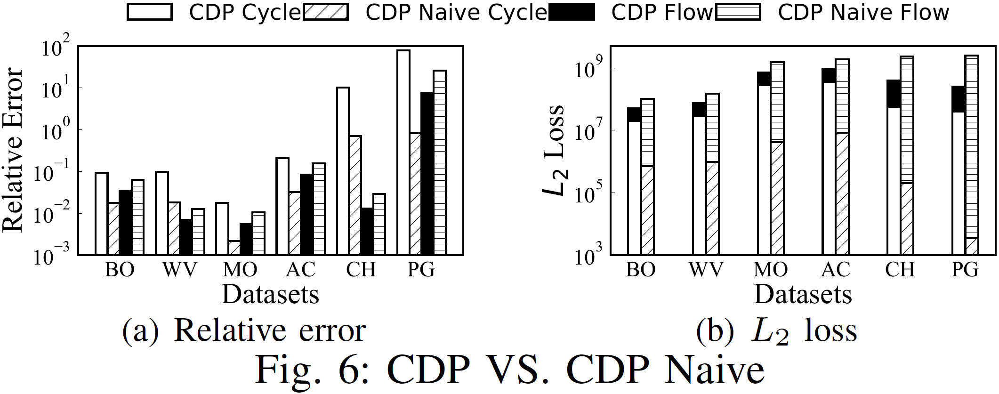
Experiments
CDP VS. CDP Naive
Notes:
Firstly, we compare CDP and CDP Naive in terms of utility on all datasets. For the sum of the $L_{2}$ loss of the numbers of cycle and flow triangles, CDP is smaller than CDP Naive. CDP reaches higher utility than CDP Naive.

Slide 26
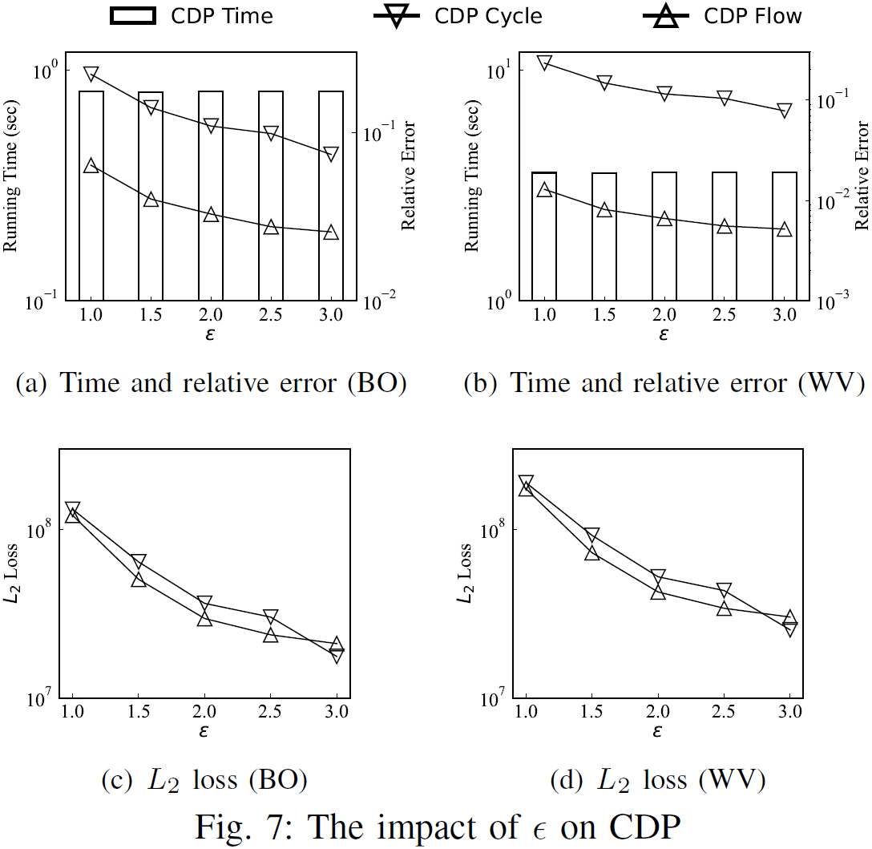
Experiments
Impact of $ε$ on CDP
Notes:
Then, we test the performance of CDP by varying the privacy budget $\epsilon$. We can observe that with the growth of $\epsilon$, (1) the running time of CDP keeps stable, and (2) both the relative error and $L_{2}$ loss of CDP decrease.

Slide 27
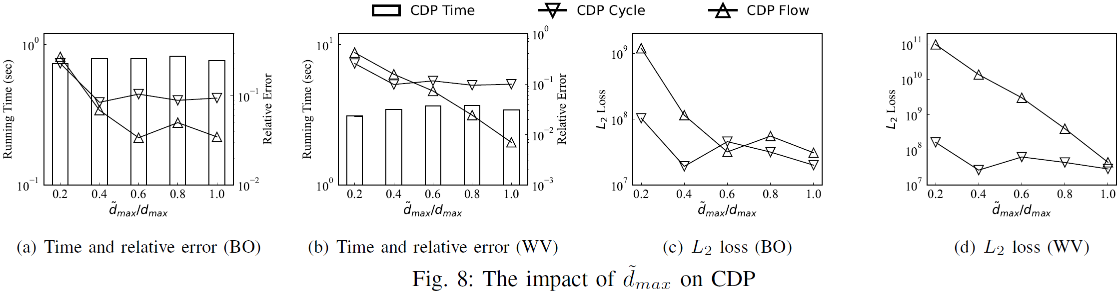
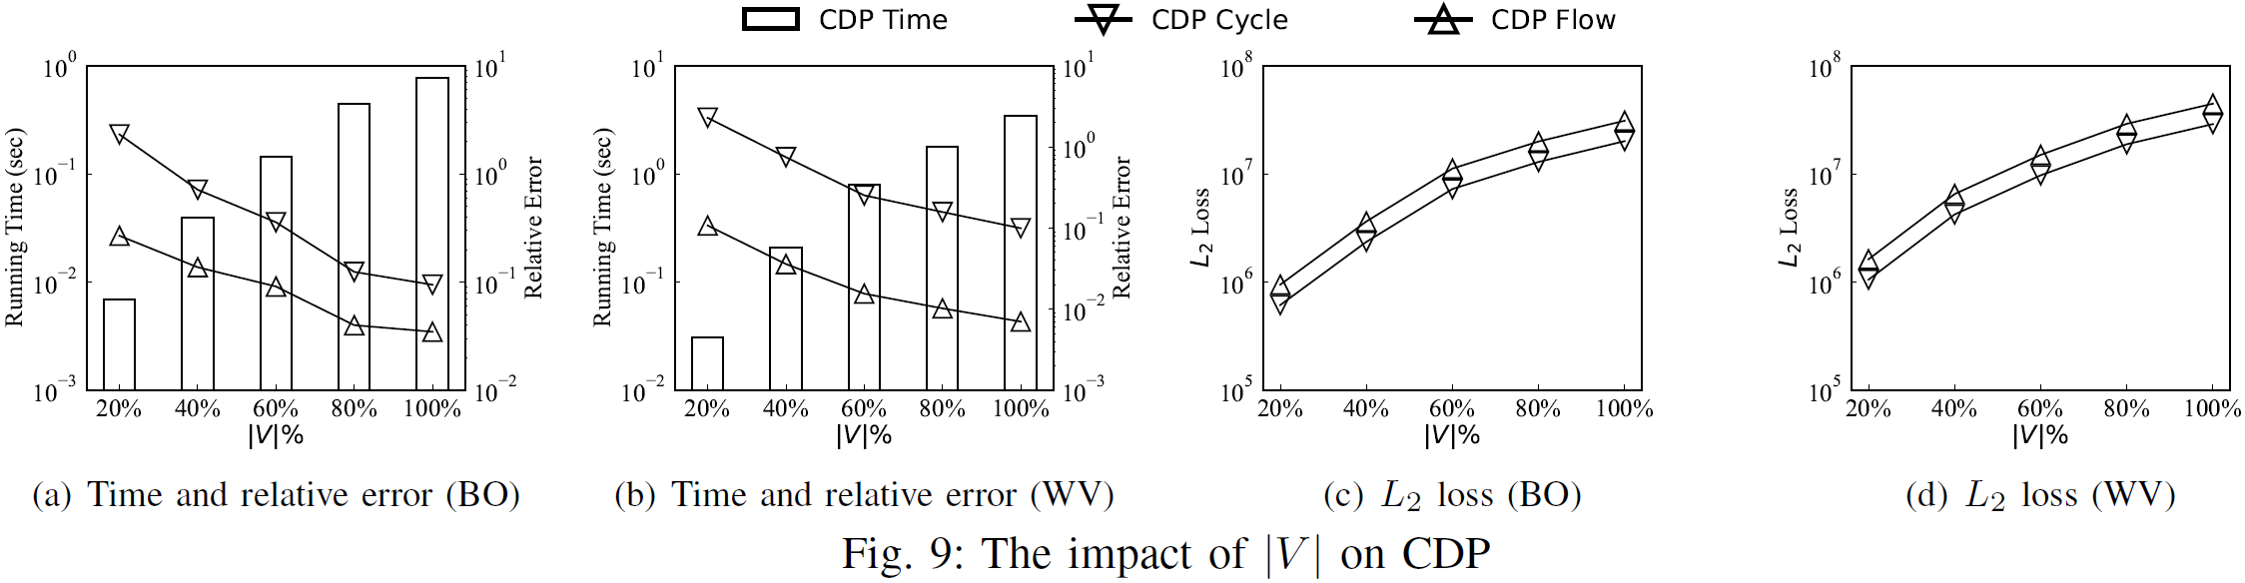
Experiments
Impact of ${\tilde{d}}_{max}$ on CDP
Impact of $|V|$ on CDP
Notes:
Next, we study the impact of projection degree $\tilde{d}_{max}$ on CDP When $\tilde{d}_{max}$ increases, the running time fluctuates slightly. This is because at least $95\%$ of the vertices have degrees no larger than $0.2d_{max}$. Hence, only a small number of vertices are affected in the graph projection process. Moreover, for small $\tilde{d}_{max}$, the difference between the projected directed graph and input directed graph is large, leading to inaccurate counting results and large relative error and $L_{2}$ loss. The larger $\tilde{d}_{max}$, the smaller difference between the projected directed graph and input directed graph. Hence, the relative error and $L_{2}$ loss of CDP decrease.
We explore the impact of graph size $|V|$ on CDP. Obviously, the larger graph, the more running time of CDP. For utility, when the graph becomes larger, the relative error of CDP decreases while the $L_{2}$ loss of CDP increases. It is because the larger graph usually contain more cycle and flow triangles. The relative error is calculated by dividing the absolute error (the difference between the counted triangle number and the actual triangle number) by the actual triangle number. When the actual triangle number increases, the relative error decreases. The $L_{2}$ loss is the square of the difference between the counted triangle number and the actual triangle number. When the actual triangle number grows, the difference becomes large as well, resulting in larger $L_{2}$ loss.

Slide 28
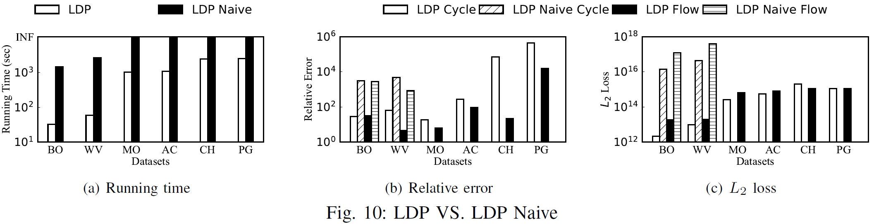
Experiments
LDP VS. LDP Naive
Notes:
We compare the performance of LDP and LDP Naive. For running time, We can observe that LDP is at least two orders of magnitude faster than LDP Naive. For the datasets MO, AC, CH, and PG, the LDP Naive can not complete within \textcolor{black}{3} hours. For the utility, both the relative error and $L_{2}$ loss of LDP are at least two orders of magnitude better than that of LDP Naive.

Slide 29
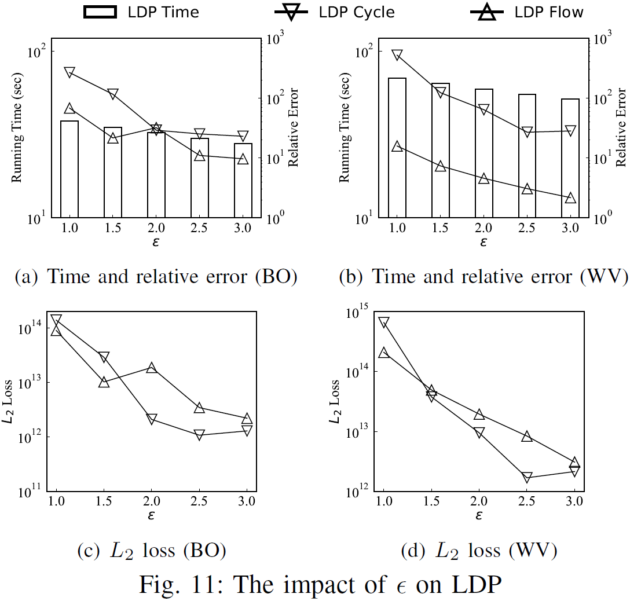
Experiments
Varying ϵ on LDP.
Notes:
Then, we test the impact of privacy budget $\epsilon$ on LDP. We can see that the running time, relative error, and $L_{2}$ loss of LDP decrease with the increase of $\epsilon$.

Slide 30
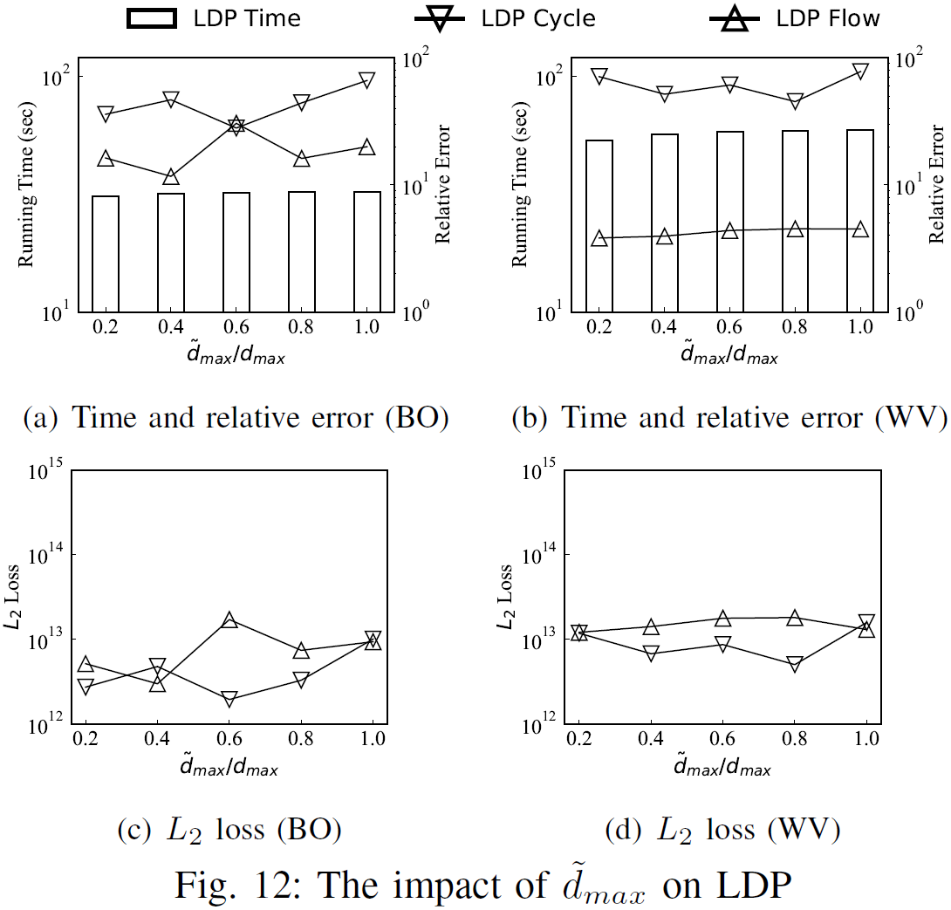
Experiments
Varying ${\tilde{d}}_{max}$ on LDP.
Notes:
Next, we evaluate the impact of projection degree $\tilde{d}_{max}$ on LDP. As the same with CDP, when $\tilde{d}_{max}$ increases, the running time of LDP almost remains stable. Moreover, the relative error and $L_{2}$ loss of LDP also do not fluctuate much.

Slide 31
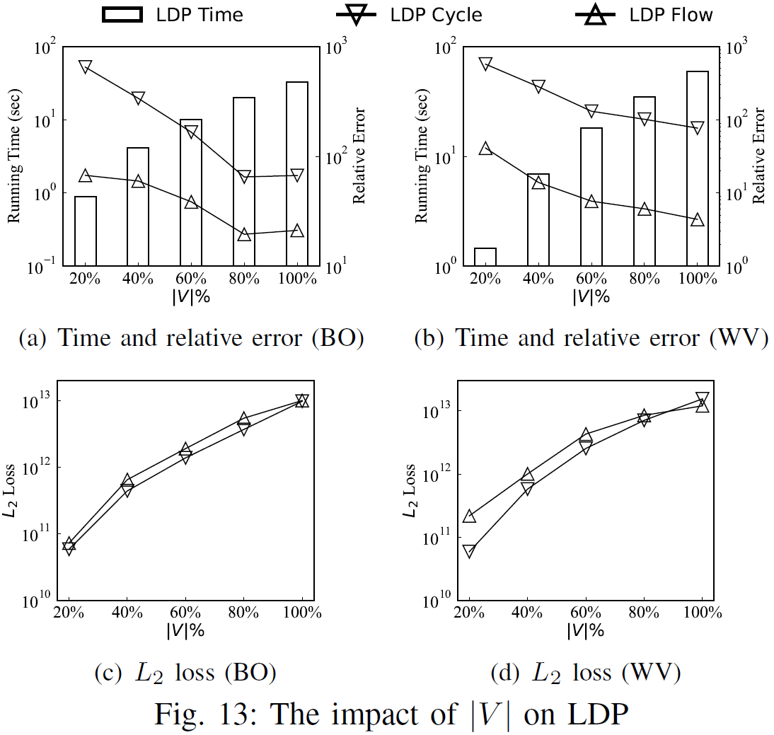
Experiments
Varying $|V|$ on LDP.
Notes:
We study the impact of graph size $|V|$ on LDP. As expected, the running time of LDP increases over larger graphs. For utility, with the growth of the graph size, the relative error of LDP decreases but the $L_{2}$ loss of LDP increases.

Slide 32
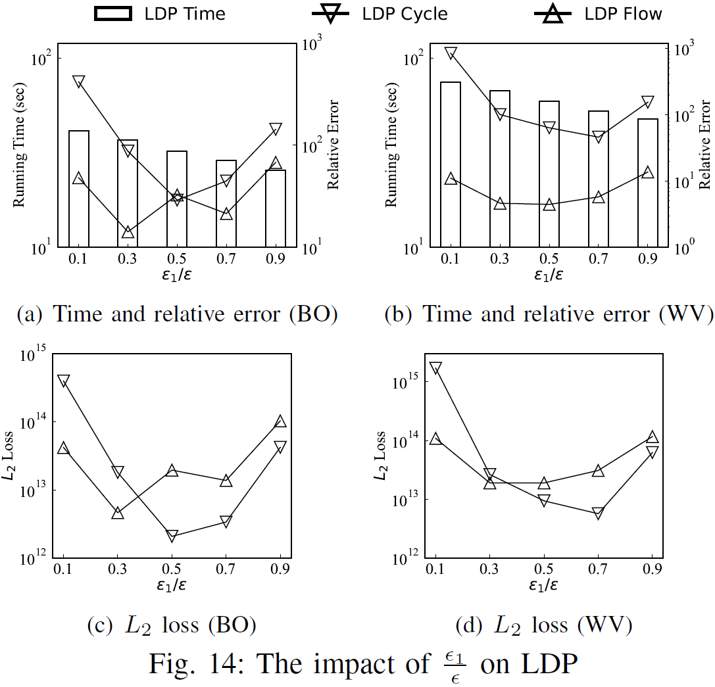
Experiments
Varying $\frac{ε_{1}}{ε}$ on LDP.
Notes:
Finally, we explore the influence of $\frac{\epsilon_{1}}{\epsilon}$ on LDP. We can observe that When $\frac{\epsilon_{1}}{\epsilon}$ increases, the running time of LDP decreases. For utility, we can see that when $\frac{\epsilon_{1}}{\epsilon}$ increases, the relative error and $L_{2}$ loss of LDP firstly decrease, and then increase. This phenomenon indicates that to achieve good utility, we can allocate the privacy budgets as evenly as possible in each stage.

Slide 33
Conclusions
We study the privacy-preserving tiangle counting problem in directed graphs.
We introduce a centralized differentially private releasing algorithm employing global sensitivity analysis.
We develop a locally differentially private releasing algorithm employing a local unbiased estimation.
Theoretical analysis and empirical evaluations confirm the efficiency and utility of our proposed algorithms.
Notes:
To conclude, in this work, (1) we study the privacy-preserving triangle counting problem in directed graphs; (2) we introduce a centralized differentially private releasing algorithm employing global sensitivity analysis; (3) we develop a locally differentially private releasing algorithm employing a local unbiased estimation; (4) theoretical analysis and empirical evaluations confirm the efficiency and utility of our proposed algorithms.

Slide 34
Thanks!
Q&A
Notes:
Thanks for your listening.

